Slide 1

SIDDHARTH INSTITUTE OF ENGINEERING & TECHNOLOGY
(AUTONOMOUS)
(Approved by AICTE, New Delhi & Affiliated to JNTUA, Ananthapuramu)
(Accredited by NBA for Civil, EEE, Mech., ECE & CSE
Accredited by NAAC with ‘A+’ Grade)
Puttur -517583,Tirupathi District, A.P. (India)
DEPARTMENT OF COMPUTER SCIENCE AND ENGINEERING
CSE (ARTIFICIAL INTELLIGENCE AND DATA SCIENCE)
Academic Year 2025-26
Project First Review
Title of Project : Intelligent Infant Health Predictor with Personalized AI Guidance
Batch Details :
S.NO: | REG NO | NAME | INTERNAL GUIDE
1 | 22F61A4788 | K LALITH | B. SRINIVASULU
2 | 22F61A4793 | P MAHITHA PRANATHI
3 | 22F61A4790 | P MADHU
4 | 22F61A4790 | K MANOJKUMAR

Slide 2
OBJECTIVE
Build a supervised Machine Learning model (CatBoost) to accurately predict infant mortality risk and classify infants into Low-Risk and High-Risk categories.
Integrate a GPT-based AI Engine (HuggingFace) to generate personalized and actionable survival plans for infants identified as high-risk.
Develop a user-friendly web interface that allows healthcare workers and caregivers to enter infant health data and instantly receive predictions and AI-generated guidance.
Enhance proactive pediatric care by combining ML-based risk assessment with tailored intervention recommendations.
Evaluate system performance using model accuracy, confusion matrix, and real/simulated datasets to ensure reliability and clinical relevance.

Slide 3
ABSTRACT (V-1)
Infant mortality continues to be a major concern in pediatric healthcare, particularly among children under the age of five. Early identification of infants at high risk enables timely preventive interventions that can greatly improve survival outcomes.
This project presents a Machine Learning and AI-powered system designed to predict infant mortality risk using key maternal and infant health indicators such as birth weight, maternal age, immunization status, nutrition score, socioeconomic category, and prenatal care visits.
A supervised ML model was trained on structured datasets, and after evaluating multiple algorithms, CatBoost emerged as the best-performing model, providing accurate classification of infants into low-risk and high-risk categories.

Slide 4
ABSTRACT (V-1)
For infants identified as high-risk, the system integrates a HuggingFace GPT-based AI engine to generate personalized survival plans. These recommendations include nutritional guidance, preventive care measures, follow-up schedules, developmental activities, and physical well-being guidelines.
A functional Flask-based backend API and a basic web interface were developed to allow caregivers and healthcare workers to input infant data and instantly receive model predictions along with AI-generated recommendations. Early evaluation has demonstrated strong prediction accuracy from CatBoost and meaningful, structured guidance from the GPT model.
The progress achieved so far highlights the potential of combining ML-driven risk assessment with AI-generated decision support to strengthen proactive pediatric care and reduce preventable infant mortality.

Slide 5
ABSTRACT (V-2)
Infant mortality remains a critical global health challenge, especially among children under the age of five. Early identification of infants who are at higher risk is essential for enabling timely intervention and improving survival outcomes.
This project introduces an integrated Machine Learning + AI–driven framework designed to assess infant mortality risk using key maternal and infant health indicators, including:
  Birth weight
  Maternal age
  Immunization status
  Nutrition score
  Socioeconomic category
  Prenatal care visits
Using these features, the system applies supervised machine learning classification techniques to predict mortality risk. Multiple models were trained and evaluated using a balanced dataset (SMOTE), and CatBoostClassifier achieved the highest accuracy and was selected as the final predictive model.

Slide 6
ABSTRACT (V-2)
Infants identified as high-risk receive a personalized survival plan generated through an integrated GPT-based AI module. These plans provide actionable, year-wise recommendations, including:
  Nutrition improvements
  Preventive healthcare steps
  Follow-up and monitoring schedules
  Early childhood developmental activities
The system is deployed through a web-based interface, enabling caregivers and healthcare workers to enter infant health details and instantly receive the ML-predicted risk along with AI-generated guidance.
With a trained CatBoostClassifier model powering risk prediction and a robust GPT engine generating structured survival plans, the system demonstrates strong potential to enhance pediatric care through data-driven decision support and intelligent recommendation generation.

Slide 7
Modules
Data Preprocessing Module
  Dataset loaded and cleaned
  Class imbalance handled using SMOTE
  Train-test split prepared
Machine Learning Module
  Multiple ML models tested (RandomForest, XGBoost etc..)
  CatBoost selected as best performer (Accuracy: 0.8746, highest among all)
  Final model exported as model.pkl
Model Evaluation Module
  Accuracy and metrics evaluated
  Confusion matrix and performance observed
  Best model validated on held-out test data
AI Survival Plan Generator Module
  Full HuggingFace GPT integration
  Custom Prompt Engineering
  Generates Personalized, year-wise survival plans (0-5 years)
Backend API Module
  Implemented with Flask
  Endpoints: /api/predict, /predict, /generate-plan
  Manages full inference pipeline: ML prediction → GPT plan → UI flow
User Interface Module
  web UI built with HTML, CSS, JavaScript
  Collects infant health inputs from user
  Displays risk score, probability meter, and AI-generated plan

Slide 8
Technological Approach
Machine Learning Layer
  Dataset cleaned, balanced using SMOTE
  Multiple models trained (RF, XGB, LGBM, CatBoost, Logistic Regression)
  Performance evaluated using Accuracy & ROC-AUC
  CatBoost Classifier selected as best model (Accuracy: 0.8746)
  Final model saved as model.pkl for inference
AI Guidance Layer
  Integrated HuggingFace GPT for generating personalized survival plans
  Structured prompt engineering using infant health features
  Output parsed into Year-wise actionable steps (0-5 years)
  Fallback system provided for API Failure or issues

Slide 9
Technological Approach
Backend Layer
  Implemented using Flask
  Core endpoints:
    /api/predict → ML + GPT prediction pipeline
    /predict → frontend-friendly alias
  Loads model.pkl, performs inference, triggers GPT, returns final structured JSON
Frontend Layer
  Basic UI built using HTML, CSS, JavaScript
  Inputs: birth weight, maternal age, immunization, nutrition, socioeconomic, prenatal visits
  Outputs: risk probability, risk category, survival plan
  Integrated animations, theme toggle, and results visualization

Slide 10
Technological Approach
Data Handling Layer
  Dataset stored as sample_input.csv
  No database implemented yet (history storage planned for next phase)
  Predictions handled in-memory during inference
Explainability Layer (Planned)
  SHAP explainability planned for feature-level insights
  Will help users understand major contributors to risk prediction

Slide 11
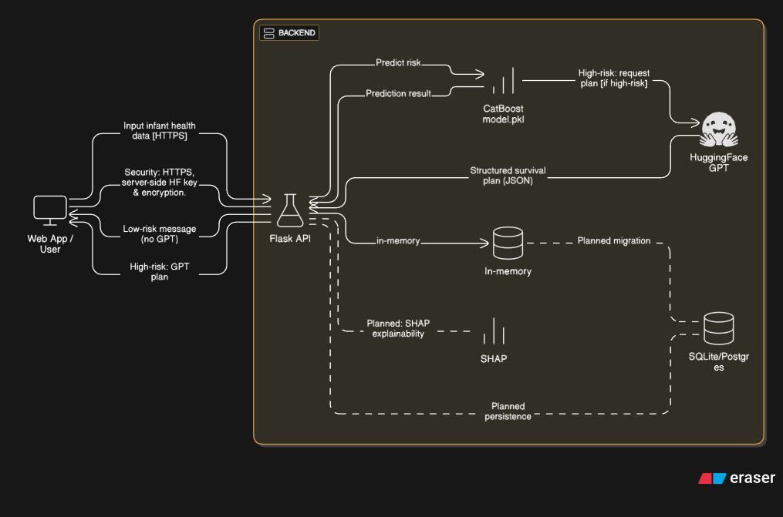
System Architecture

Slide 12
Conclusion
The system successfully integrates Machine Learning (CatBoost) and GPT-based AI to predict infant mortality risk and provide personalized survival plans.
A working Flask Backend API and Web UI enable real-time prediction and guidance delivery.
Early evaluations show strong model accuracy (0.8746) and meaningful, structured AI recommendations.
The combined ML–AI approach demonstrates significant potential to support proactive pediatric care and improve early intervention outcomes.
Planned enhancements include persistent storage, SHAP explainability, and expanded clinical validation to further strengthen system reliability and impact.

